Slide 1
ECE 214
Pre-requisites:
Electrical Circuits, Circuit Theory, Understanding of Electronic Devices
Course Focus:
Electronic Circuits based on BJT and CMOS
Tutorials:
Every week
Will be led by TF and TAs
Lab Components:
Simulations (LT Spice)
Usage of Electronic Lab
Our Engineers and TF will be leading the lab aspects
Course Outline and Details:
Posted on Google Classroom
Lecture slides will be uploaded after the lecture

Slide 2
Details about Course Dynamics
Lab Components :
Simulation on LT Spice (Tutorial Slots may be utilized)
PCB Designing
Usage of Electronic Laboratory (Hardware Part)
Our Engineers and TF will be leading the lab aspects
Course Outline and Details:
Posted on Google Classroom
Lecture slides will be uploaded after the lecture
Evaluation Mechanism
Text Book:
“Microelectronic Circuits” by A. Sedra and K. Smith, 7th Ed., Oxford University Press.
Assessment Plan
Type of Evaluation | % Contribution in Grade
Semester Project | 10
Quiz | 10
Mid-sem | 20
End-sem | 30
LAB | 20
Tutorial and Simulation | 10

Slide 3
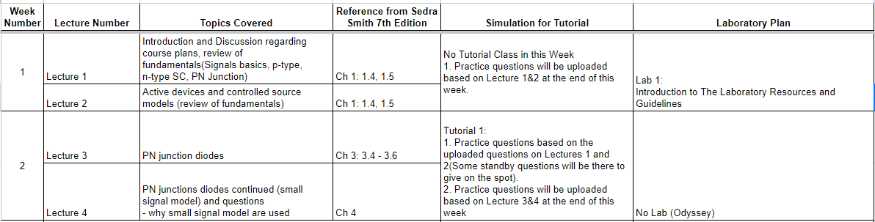
Lecture/Tutorial/Lab Dynamics
Expected Number of Lectures - 23
Labs Experiments - 6
Projects - Remaining Lab Slots
PCB Fabrication

Slide 4
Tentative Timeline
Final Exam: Exam week at the end of term
Mid-Term: During Midterm Week
Quiz: 2 Quizzes
Project and Lab
Project starts Week-7
Final Demo: by 16th week

Slide 5
Lecture – 1
ECE 214
Introduction
Review of Fundamentals

Slide 6
ECE 214
Signals
What is a Signal?
Signals contain information about a variety of things and activities in our physical world.
Eg. Temperature, Pressure, Heat, Sound etc.
These signals are often physical in nature. Eg. Sound as longitudinal acoustic waves.
Often one may need to process these signals for many reasons:
Amplify
Communication: Long Distances
Compression and Storage.
These processes are achieved while using electronic circuits. Hence, the physical signal must be identically converted into an identical electrical equivalent.

Slide 7
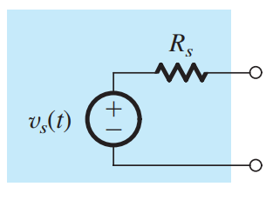
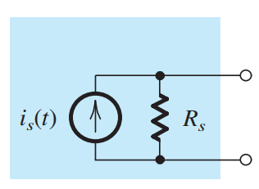
ECE 214
Signals
Electrical Equivalent of Physical Signal
Physical signals are converted to their electrical equivalent signals while using devices known as transducers.
Eg. The pressure transducer in the microphone generates an electrical signal analogous to sound/voice longitudinal signal.
The electrical signals are often represented as either a voltage source (Thevenin Equivalent) or as a Current Source (Norton Equivalent).
Thevenin Equivalent Voltage Source
Norton Equivalent Current Source
Although the two representations are equal, the Thevenin form) is preferred when Rs is low while the Norton form is preferred when Rs is high

Slide 8
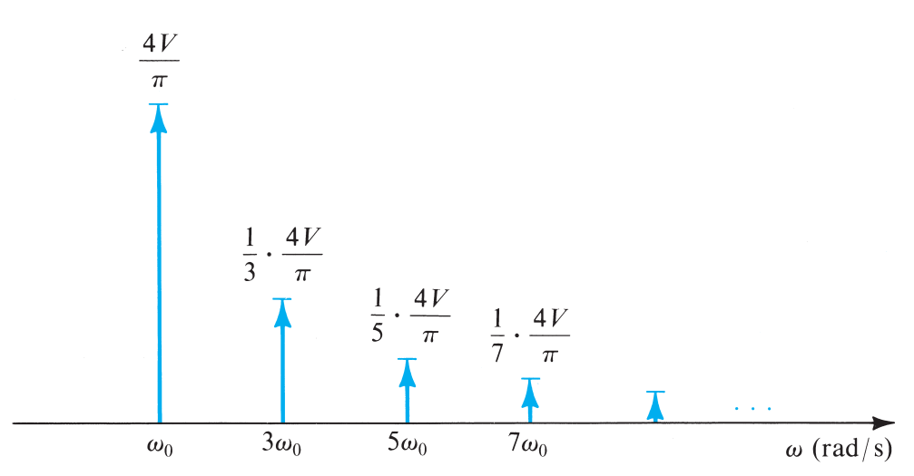
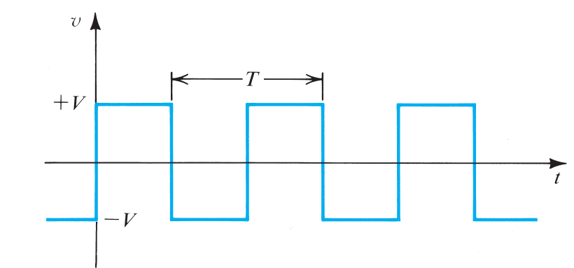
ECE 214
Signals
Frequency Spectrum of Signals
Often electrical signals are an arbitrary function of time ‘t’. Just by looking at them not all information may be derived.
An important aspect is to also look at the frequency spectrum of a signal which will indicate the net contribution of each harmonic on a signal power.
Fourier Series and Fourier Transform are important mathematical tools for a communication engineer. They indicate the sinusoids that come together to achieve arbitrary signals under study.
Fourier Series

Slide 9
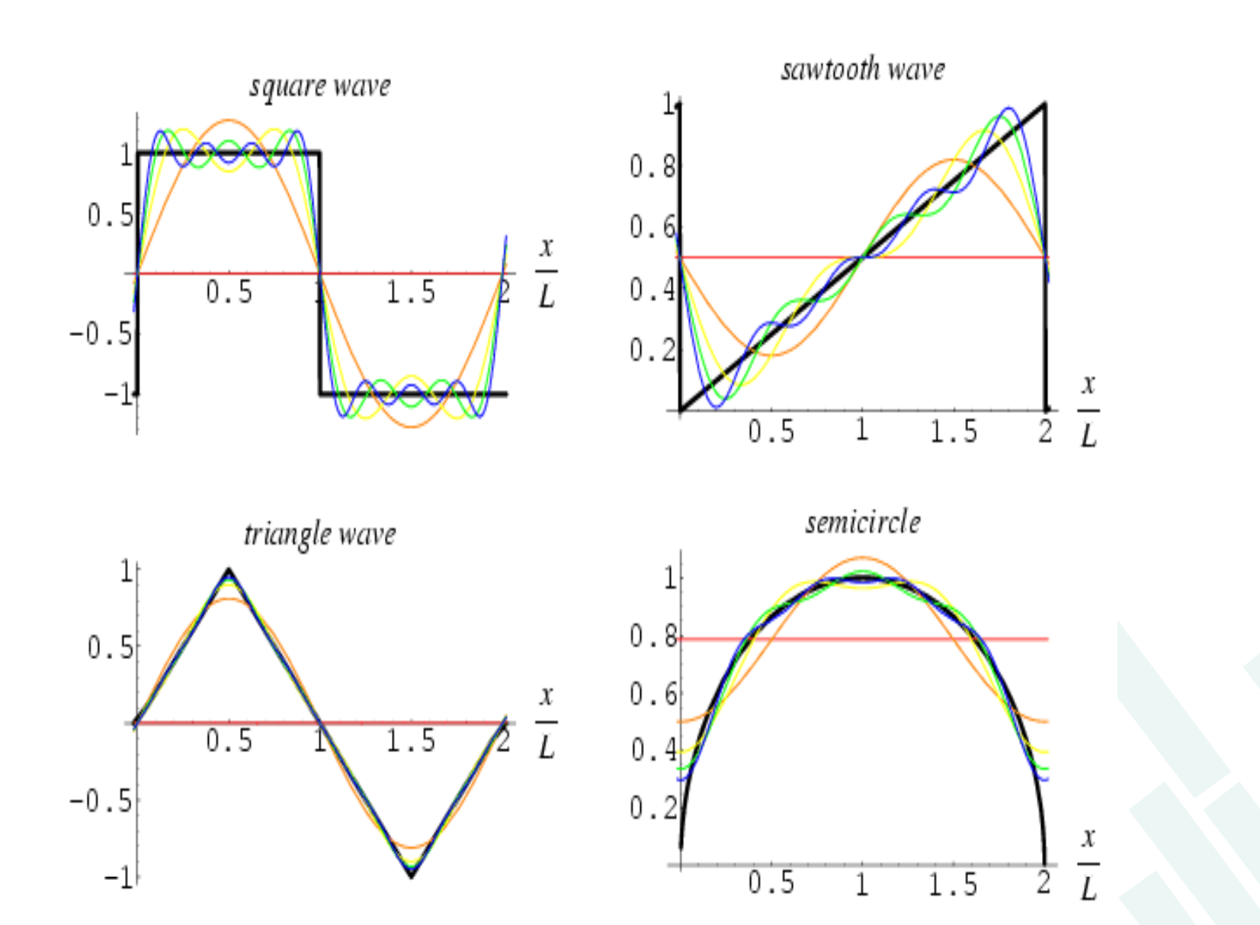
ECE 214
Signals

Slide 10
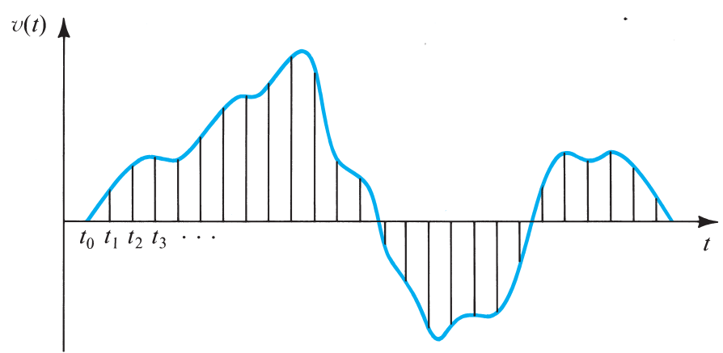
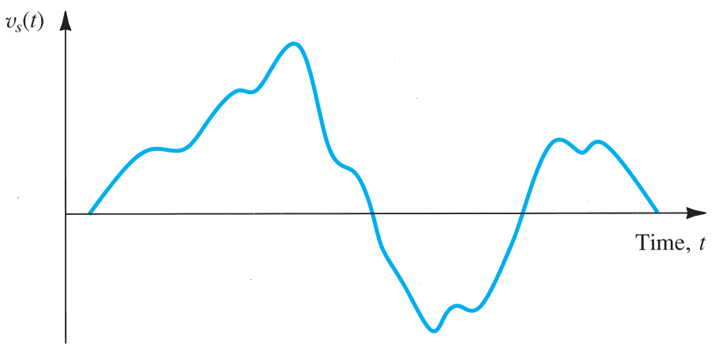
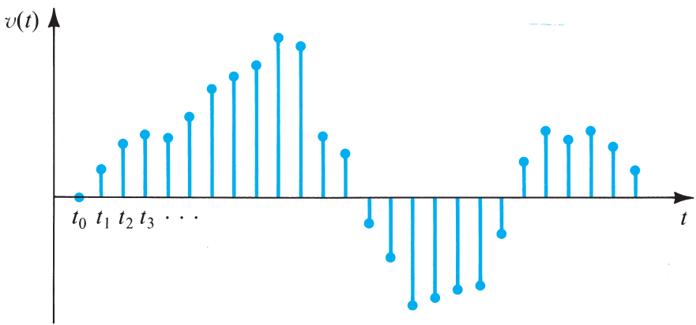
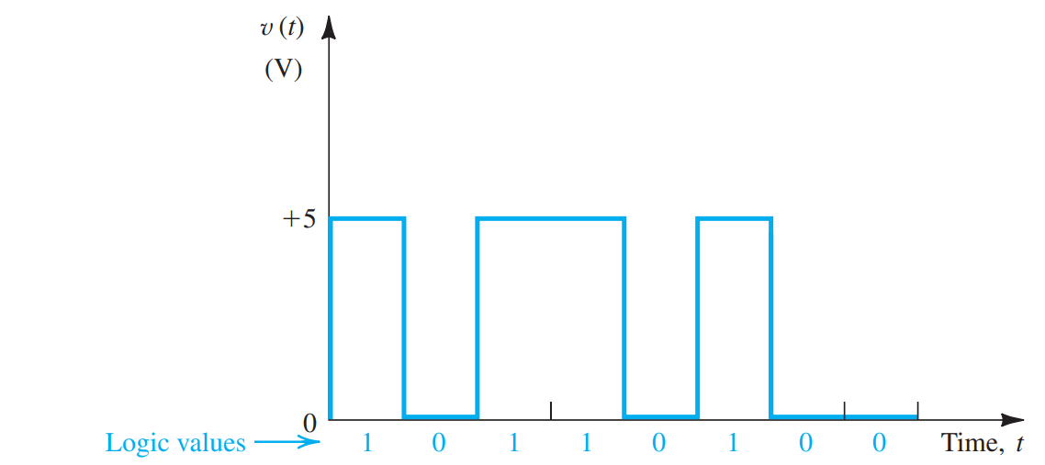
ECE 214
Signals
Sampling
Analog Signal
Discrete Signal
Quantization
Discrete Signal
Digital Signal

Slide 11
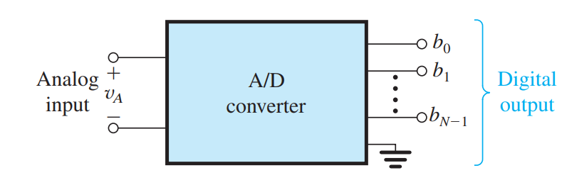
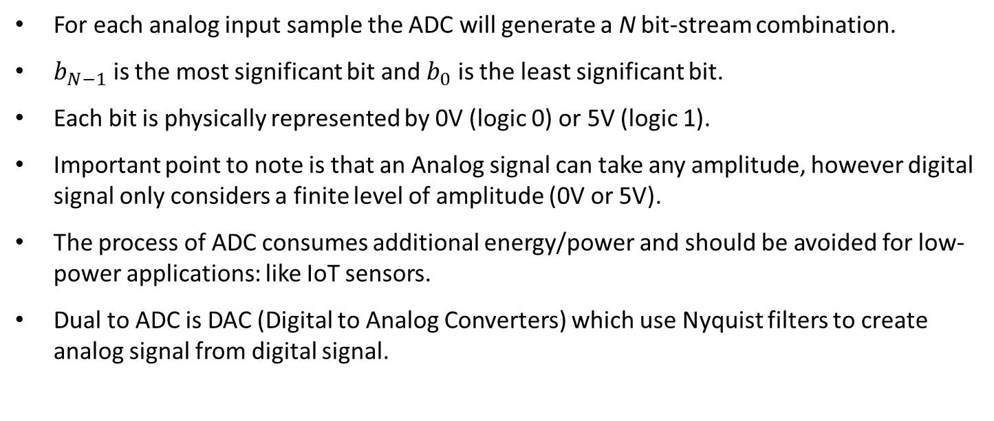
ECE 214
Signals
Analog to Digital Converter
For each analog input sample the ADC will generate a N bit-stream combination.
$b_{N−1}$ is the most significant bit and $b_{0}$ is the least significant bit.
Each bit is physically represented by 0V (logic 0) or 5V (logic 1).
Important point to note is that an Analog signal can take any amplitude, however digital signal only considers a finite level of amplitude (0V or 5V).
The process of ADC consumes additional energy/power and should be avoided for low-power applications: like IoT sensors.
Dual to ADC is DAC (Digital to Analog Converters) which use Nyquist filters to create analog signal from digital signal.

Slide 12
ECE 214
Amplifiers
The most fundamental signal-processing function, one that is employed in
some form in almost every electronic system, namely, signal amplification.
For now, we consider the amplifier as a circuit building-block;
that is, we shall consider its external characteristics.
From a conceptual point of view the simplest signal-processing task is that of signal amplification.
The need for amplification arises because transducers provide signals that are said to be “weak,” that is, in the microvolt (μV) or millivolt (mV) range and possessing little energy.
Such signals are too small for reliable processing, and processing is much easier if the signal magnitude is made larger.
The functional block that accomplishes this task is the signal amplifier.

Slide 13

ECE 214
Amplifiers
Linearity of amplifiers is extremely important.
Care must be exercised in the amplification of a signal, so that the information
contained in the signal is not changed and no new information is introduced.
Thus when we feed the signal to an amplifier, we want the output signal of the amplifier to be an exact replica of that at the input, except of course for having larger magnitude.
In other words, the “wiggles” in the output waveform must be identical to those in the input waveform.
Any change in waveform is considered to be distortion and is obviously
undesirable.
A linear amplifier is characterized by the relationship
v_{i} and v_{o} are the input and output signals, respectively, and A is a constant
representing the magnitude of amplification, known as amplifier gain.

Slide 14
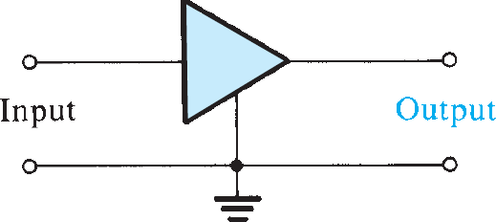
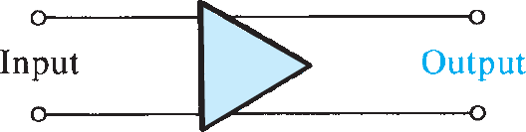
ECE 214
Amplifiers
The linear amplifiers are primarily intended to operate on very small input
signals.
Their purpose is to make the signal magnitude larger and therefore are thought of as Voltage Amplifiers.
The Preamplifier in the home stereo system is an example of a
voltage amplifier.
Another type of amplifier, namely, the Power Amplifier.
Such an amplifier may provide only a modest amount of voltage gain
but substantial current gain.
The main amplifier in your mobile phone is a Power Amplifier.

Slide 15
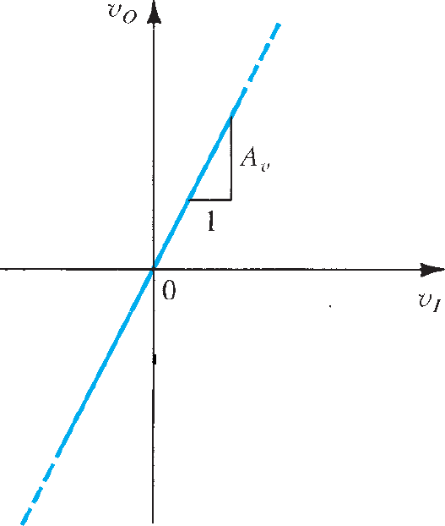
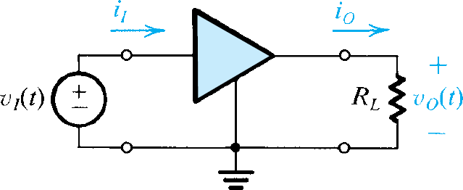


ECE 214
Voltage Gain
A linear amplifier accepts an input signal v_{I}(t) and provides at the output, across a load resistance R_{L}, an output signal v_{O}(t) that is a magnified replica of v_{I} (t).

Slide 16




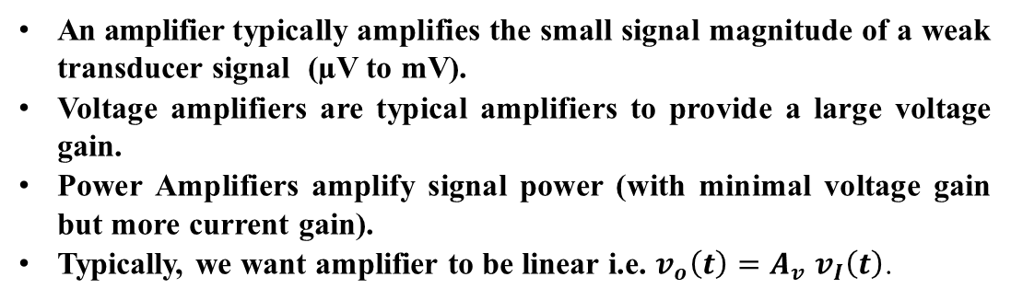
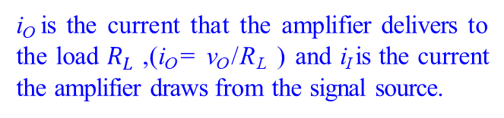
Power and Current Gains
An amplifier typically amplifies the small signal magnitude of a weak transducer signal (µV to mV).
Voltage amplifiers are typical amplifiers to provide a large voltage gain.
Power Amplifiers amplify signal power (with minimal voltage gain but more current gain).
Typically, we want amplifier to be linear i.e. $v_{o}\left(t\right)=A_{v}$ $v_{I}\left(t\right)$.
i_{O} is the current that the amplifier delivers to the load $R_{L}$), i_{O} = v_{O} /R_{L} ) and i_{I} is the current the amplifier draws from the signal source.

Slide 17
Gains in Decibels
For a number of reasons, amplifier gain is often defined with a logarithmic measure.
The absolute values of the voltage and current gains are used because in some cases A_{v} or A_{i} will be a negative number. → A negative gain A_{v} simply means that there is a 180° phase difference between input and output signals; it does not imply that the amplifier is attenuating the signal.
On the other hand, an amplifier whose voltage gain in dB is, say, –20 dB is in fact attenuating the input signal by a factor of 10 (i.e., A_{v} = 0.1 V/V).

Slide 18
Gains in Decibels
The absolute values of the voltage and current gains are used because in some cases A_{v} or A_{i} will be a negative number. → A negative gain A_{v} simply means that there is a 180° phase difference between input and output signals; it does not imply that the amplifier is attenuating the signal.
On the other hand, an amplifier whose voltage gain magnitude in dB is, say, –20 dB

Slide 19
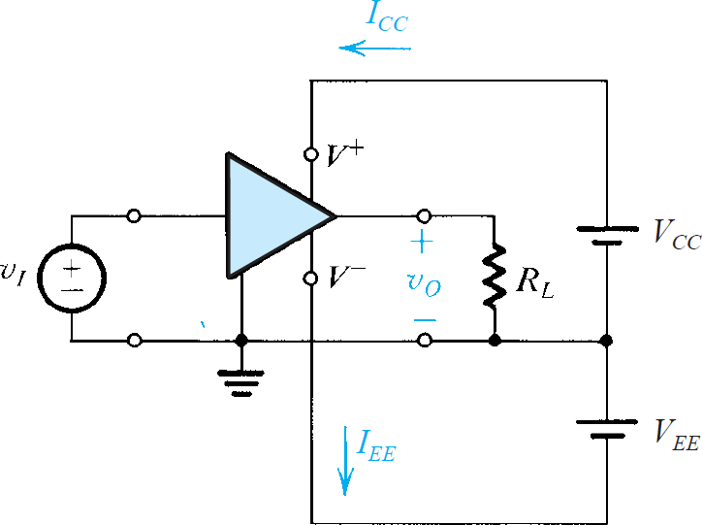
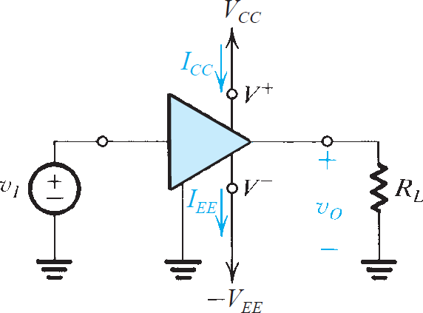


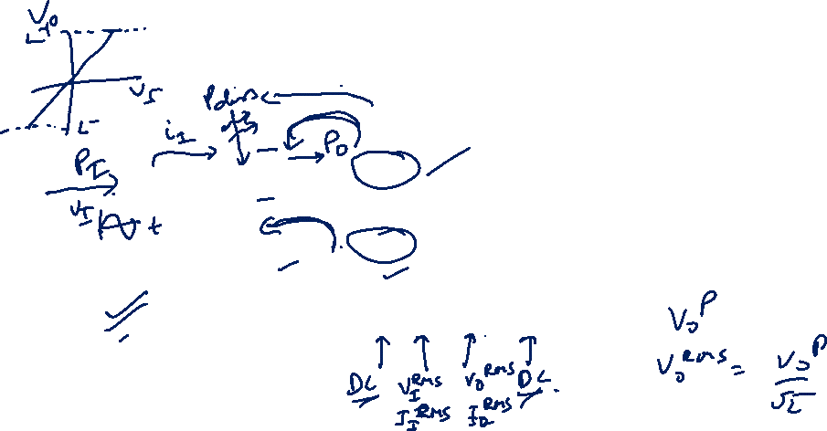
Amplifier Power Supplies
Power delivered to the load is greater than the power drawn from the signal source, then the question arises as to the source of this additional power.
The answer is found by observing that amplifiers need dc power supplies for their operation. These dc sources supply the extra power delivered to the load as well as any power that might be dissipated in the internal circuit of the amplifier (such power is converted to heat).

Slide 20




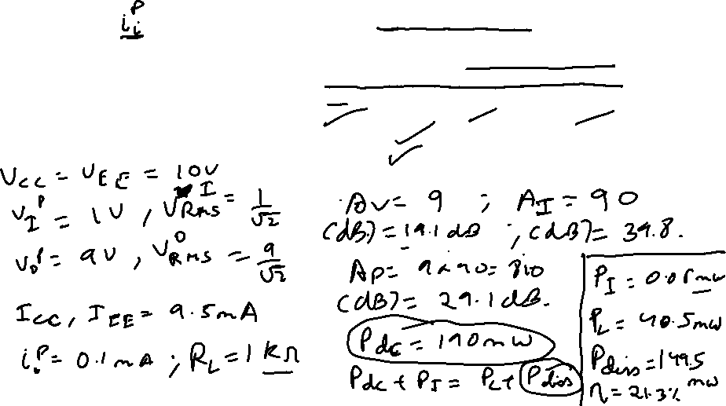
Example – 1
This amplifier operates from ±10𝑉 power supplies. It is fed with a sinusoidal voltage having 1V peak and delivers a sinusoidal voltage output of 9V peak to a 1-kΩ load. The amplifier draws a current of 9.5 mA from each of its two power supplies. The input current of the amplifier is found to be sinusoidal with 0.1 mA peak. Find:
(a) the voltage gain, (b) the current gain, (c) the power gain, (d) the power drawn from the dc supplies, (e) the power dissipated in the amplifier, and (f) the amplifier efficiency.

Slide 21






Example – 1

